Slide 1
Azure Study Group AZ-300 - Microsoft Azure Architect Technologies
Shawn Weisfeld
Cloud Solution Architect

Slide 2
Week 3 Create and deploy apps (5-10%)

Slide 3
Agenda
Agenda
1
Speaker Introduction
2
Feedback Loop
3
Objective Review
4
Open Mic
5

Slide 4
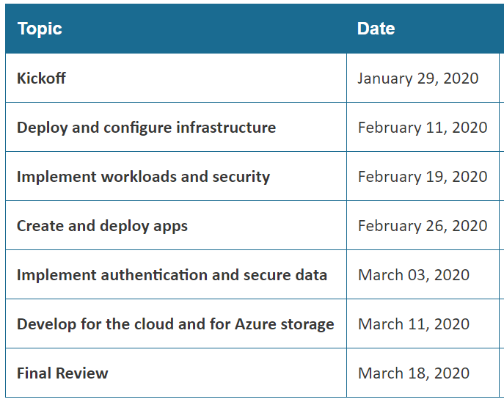
Series Agenda
Yammer: https://aka.ms/azurecsg
Homework:
https://aka.ms/AZ-300StudyGroup

Slide 5

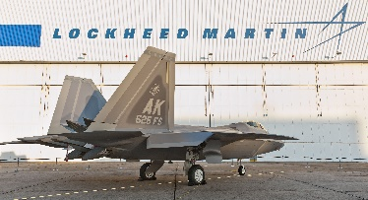




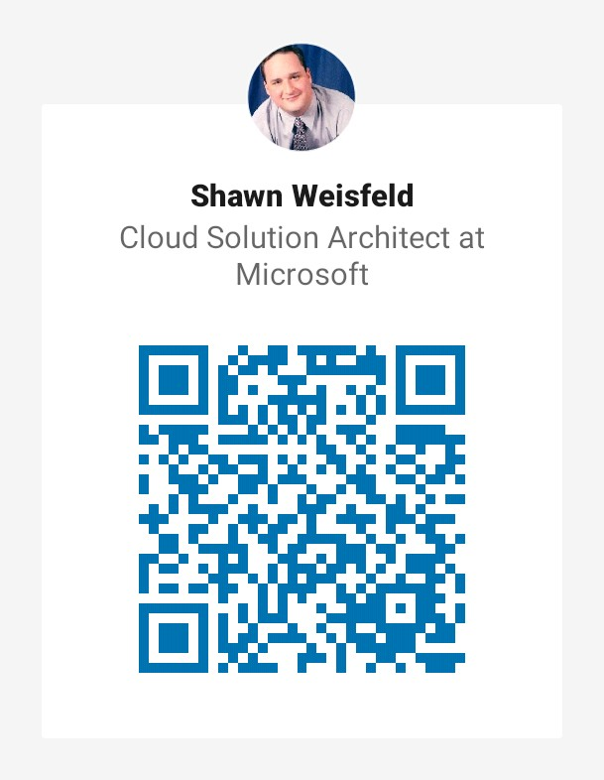


















Slide 6
Feedback Loop

Slide 7
Create web apps by using PaaS
create an Azure app service Web App
create documentation for the API
create an App Service Web App for Containers
create an App Service background task by using WebJobs
enable diagnostics logging

Slide 8
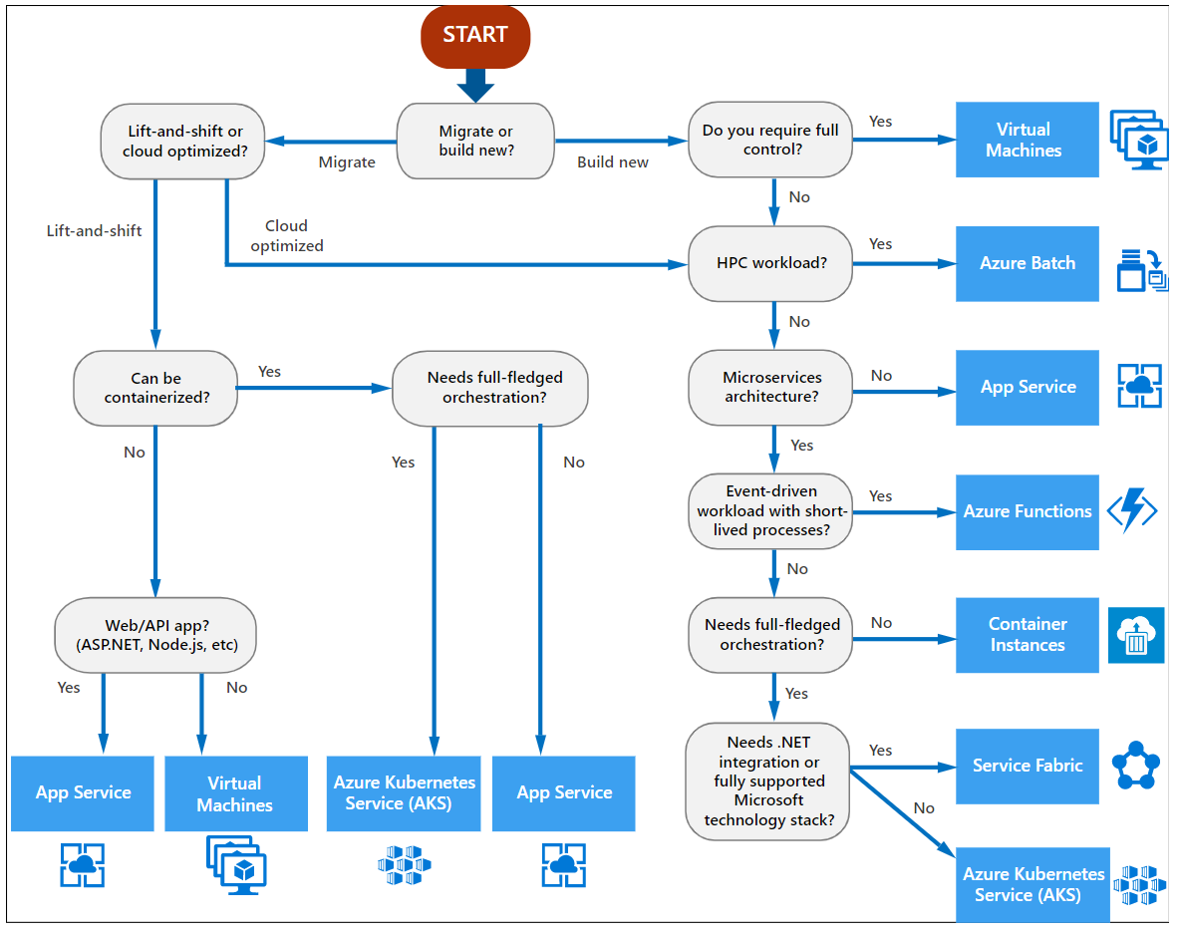
What do I pick?

Slide 9
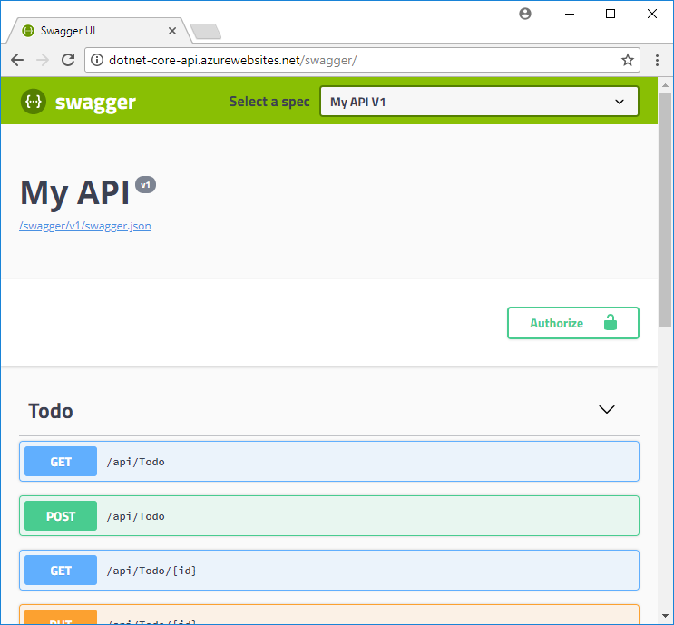
Document your API

Slide 10

App Service & Containers
Windows & Linux containers available
Provides the benefits of App Service and Containers without the overhead of a cluster.

Slide 11
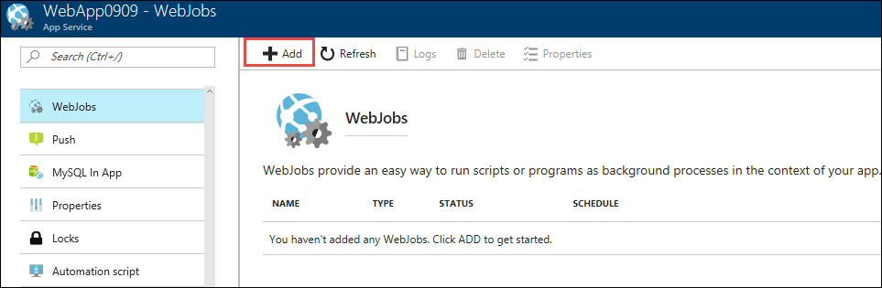
App Service WebJobs
Continuous vs Triggered
WebJobs vs Azure Functions

Slide 12
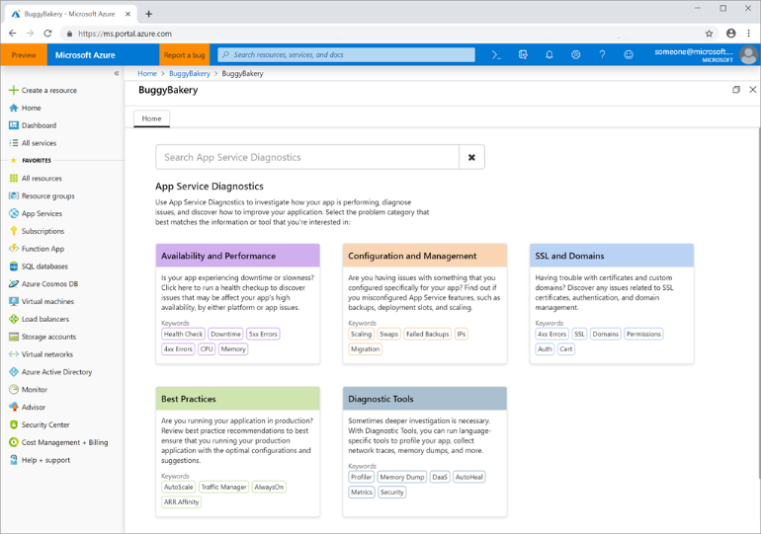
Azure App Service diagnostics
** not mentioned in this objective, but Azure Monitor Application Insights can also help with this

Slide 13
Design and develop apps that run in containers
configure diagnostic settings on resources
create a container image by using a Dockerfile
create an Azure Kubernetes Service
publish an image to the Azure Container Registry
implement an application that runs on an Azure Container Instance
manage container settings by using code

Slide 14
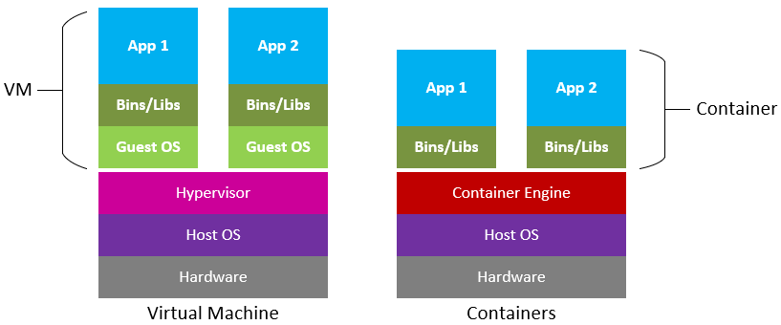
What is a container?

Slide 15
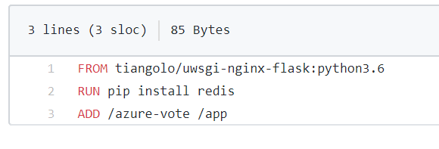
How do I build a Container?
Dockerfile & Docker Compose

Slide 16
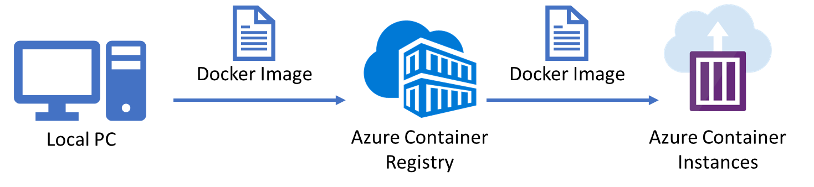
Where do I keep my containers?
Container Registry or like service

Slide 17
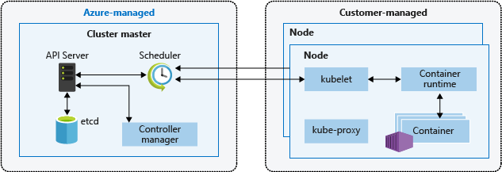
Where do I run my containers?
Azure Kubernetes Service

Slide 18
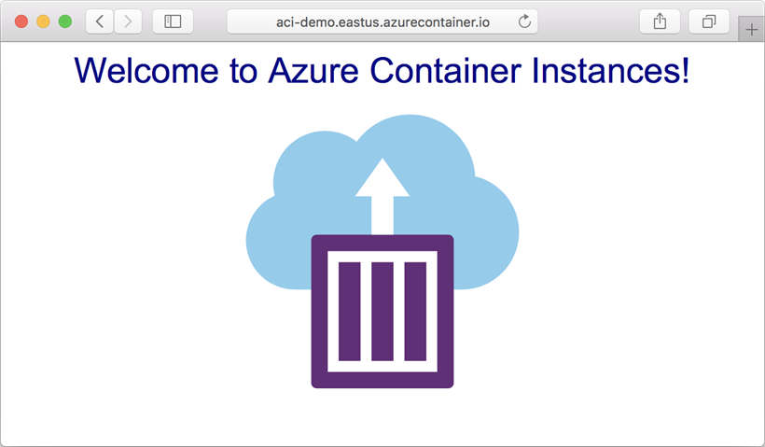
Where do I run my containers?
Azure Container Instance

Slide 19
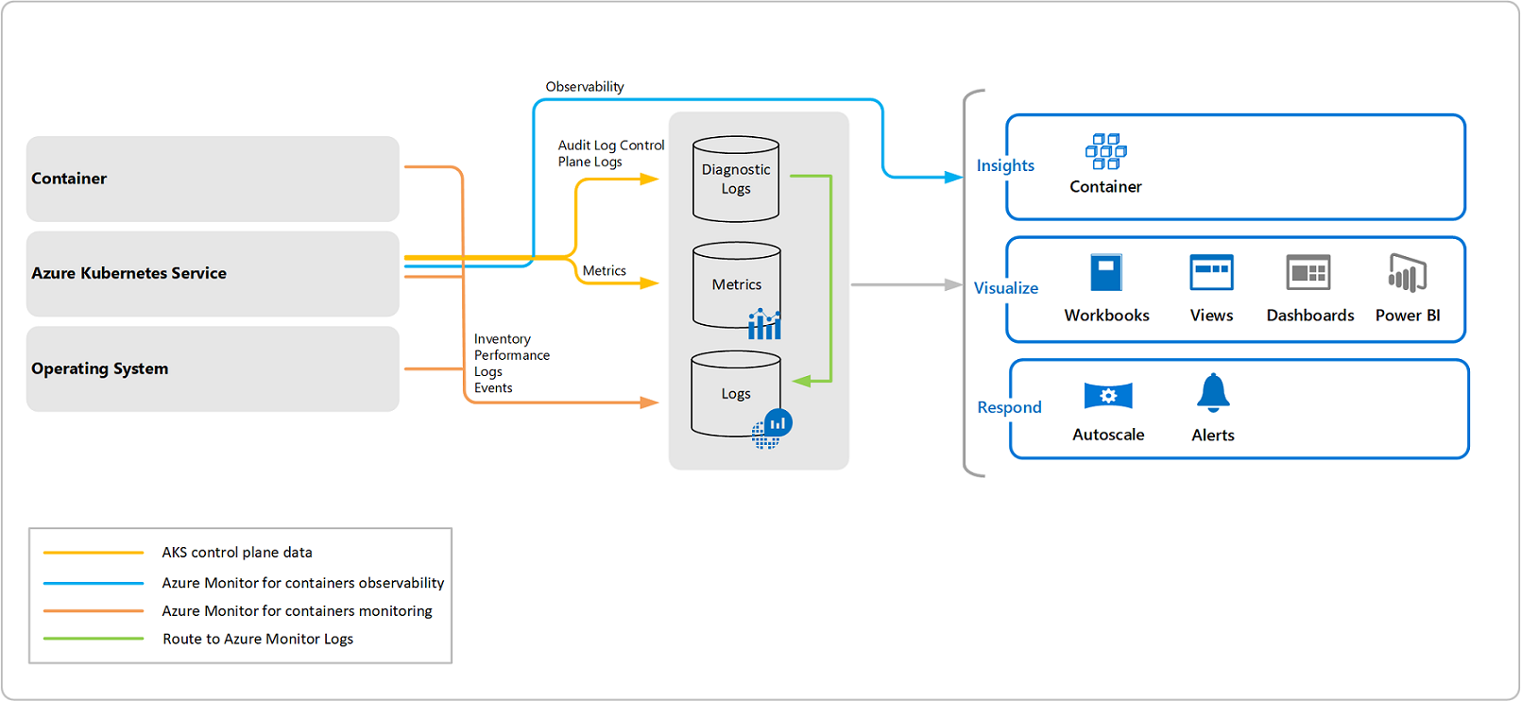
How do I monitor my containers are doing?
Azure Monitor for containers (aka Container Insights)
Containers running anywhere

Slide 20
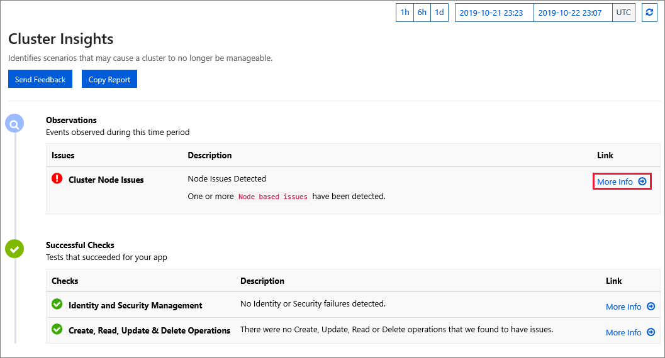
How do I monitor my containers are doing?
AKS Diagnostics – part of the AKS service

Slide 21
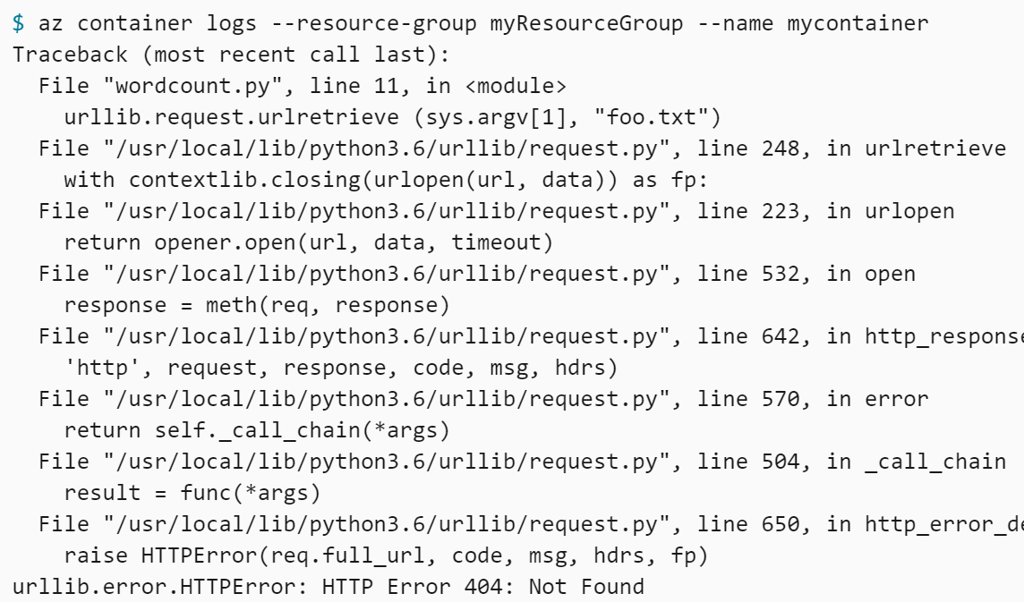
How do I monitor my containers are doing?
ACI Logs – part of the ACI service

Slide 22
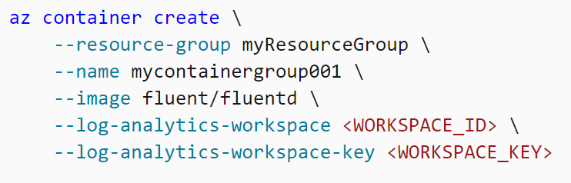
How do I monitor my containers are doing?
ACI with Azure Monitor Logs

Slide 23
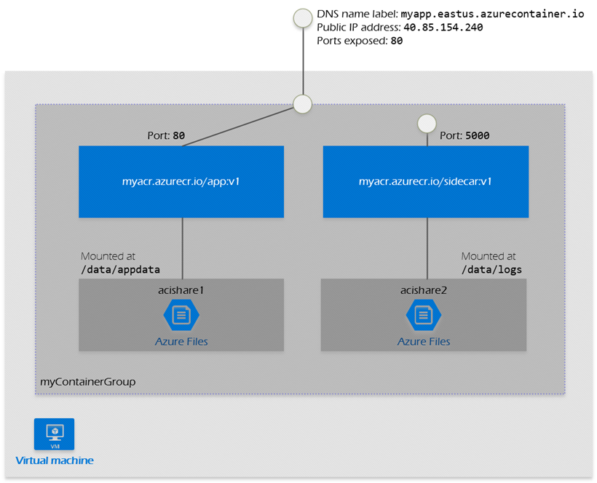
Building more complex apps with ACI: Container Groups
Same host machine, lifecycle, resources, local network, and storage volumes.
Like a pod in AKS.

Slide 24


Questions?

Slide 25
Homework Assignment
https://aka.ms/AZ-300StudyGroup

Slide 26

Open Mic …

